Slide 1
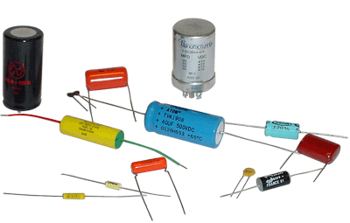
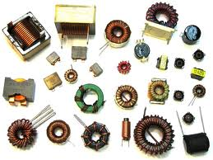
EBN 111/122 ELECTRICITY AND ELECTRONICS
Chapter 6
Capacitors and Inductors

Slide 2
Capacitors and Inductors Chapter 6
6.2 Capacitors
6.3 Series and Parallel Capacitors
6.4 Inductors
6.5 Series and Parallel Inductors

Slide 3
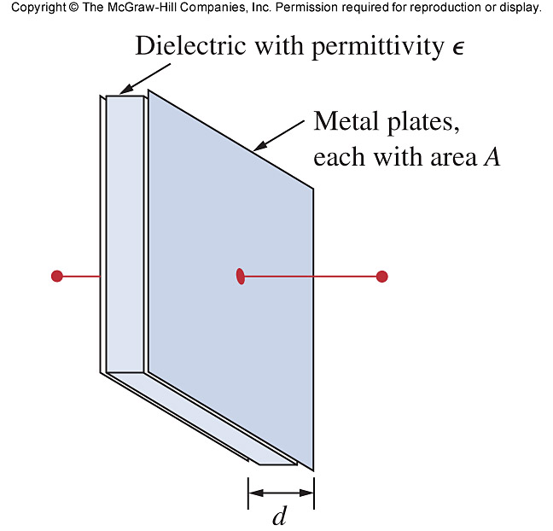
6.2 Capacitors Physical characteristics
A capacitor is a passive element designed to store energy in its electric field.
A capacitor consists of two conducting plates separated by an insulator (or dielectric).
A = Surface are of the metal plate [m²]
ε = permittivity of the dielectric [F/m]
d = distance between plates [m]
ε = ε_{r} ε₀
ε_{r} = Relative permittivity of material
ε₀ = Permittivity of air (8.854 x 10⁻¹² F/m)

Slide 4
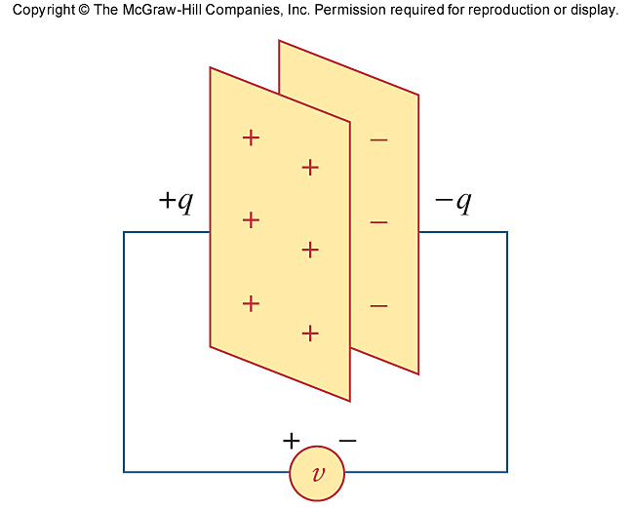
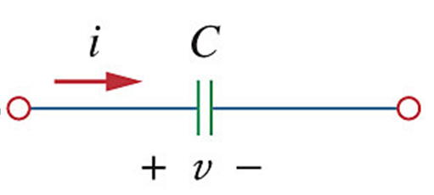
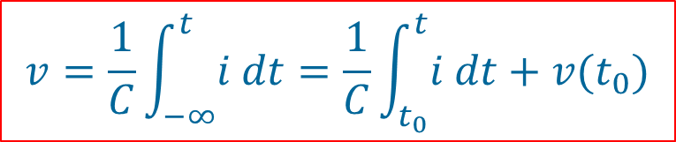
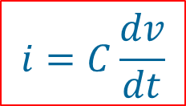
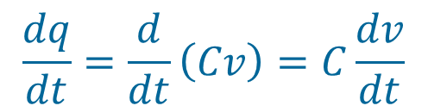

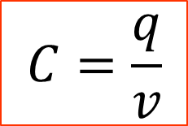
6.2 Capacitors Electrical characteristics
Capacitance C is the ratio of the charge q on one plate of a capacitor to the voltage difference v between the two plates, measured in farads (F).
$$q=Cv$$
$$\frac{dq}{dt}=\frac{d}{dt}\left(Cv\right)=C\frac{dv}{dt}$$
$$i=C\frac{dv}{dt}$$
If i > 0: Capacitor is charging.
If i < 0: Capacitor is discharging.
$$C=\frac{q}{v}$$
OR
$$v=\frac{1}{C}\int_{−∞}^{t}{i dt}=\frac{1}{C}\int_{t_{0}}^{t}{i dt}+v(t_{0})$$

Slide 5
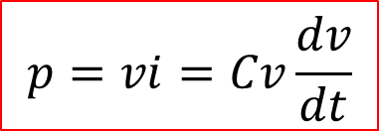
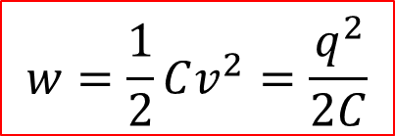

6.2 Capacitors Energy and Power
The energy, w, stored and power p in the capacitor is:
$$w=\frac{1}{2}Cv^{2}=\frac{q^{2}}{2C}$$
$$p=vi=Cv\frac{dv}{dt}$$
$$i=C\frac{dv}{dt}$$
Important characteristics of capacitors:
It is an open circuit to dc (dv/dt = 0).
Its voltage cannot change abruptly (dv/dt = ∞).
Does not dissipate energy, but stores it when charging or provides it when discharging.

Slide 6
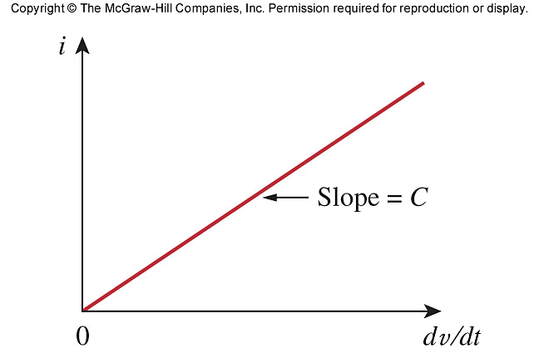

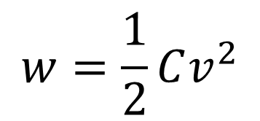
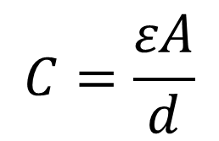
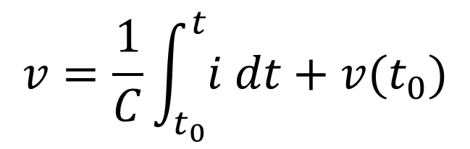
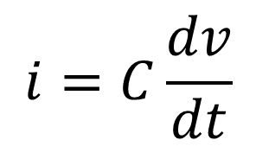
6.2 Capacitors New Equations
$$q=Cv$$
V-I characteristic of a Cap
$$C=\frac{εA}{d}$$
$$i=C\frac{dv}{dt}$$
$$v=\frac{1}{C}\int_{t_{0}}^{t}{i dt}+v(t_{0})$$
$$w=\frac{1}{2}Cv^{2}$$

Slide 7
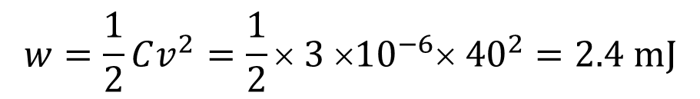
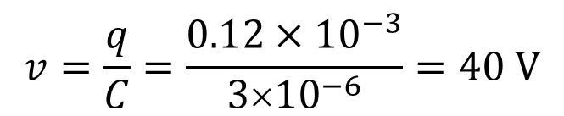

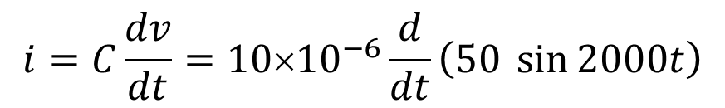
PP 6.1 What is the voltage across a 3μF capacitor if the charge on one plate is 0.12 mC. How much energy is stored in the capacitor?
$$v=\frac{q}{C}=\frac{0.12×{10}^{−3}}{3×{10}^{−6}}=40 V$$
$$w=\frac{1}{2}Cv^{2}=\frac{1}{2}× 3 ×{10}^{−6}× {40}^{2}=2.4 mJ$$
PP 6.2 The voltage source connected across a 10 μF capacitor is given as:
v(t) = 50 sin 2000t V. Calculate i(t).
$$i=C\frac{dv}{dt}=10×{10}^{−6}\frac{d}{dt}\left(50 \sin{2000t}\right)$$
$$=10×{10}^{−6}× 50 × 2000 × \cos{2000t}$$
$$=\cos{2000t A}$$

Slide 8
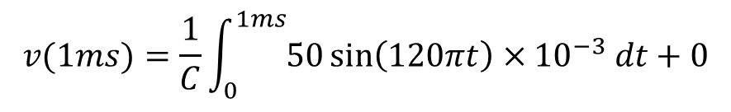
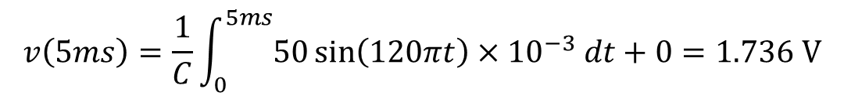
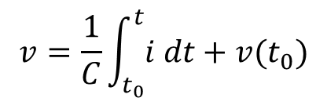
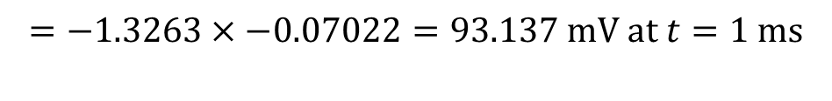
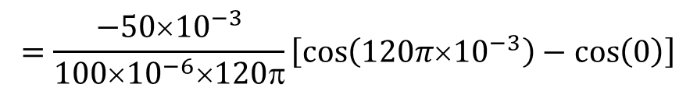
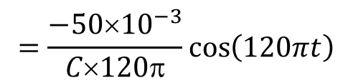
PP 6.3 If the current through a 100 μF capacitor is given as:
i(t) = 50 sin (120πt) mA, calculate v(1ms) and v(5ms).
Assume v(0) = 0 V
$$v=\frac{1}{C}\int_{t_{0}}^{t}{i dt}+v(t_{0})$$
$$v(1ms)=\frac{1}{C}\int_{0_{}}^{1ms}{50\sin\left(120πt\right)×{10}^{−3} dt}+0$$
1ms
$$=\frac{−50×{10}^{−3}}{C×120π}\cos\left(120πt\right)$$
0
$$=\frac{−50×{10}^{−3}}{100×{10}^{−6}×120π}\left[\cos\left(120π×{10}^{−3}\right)−\cos\left(0\right)\right]$$
$$=−1.3263×−0.07022=93.137 mV at t=1 ms$$
$$v\left(5ms\right)=\frac{1}{C}\int_{0_{}}^{5ms}{50\sin\left(120πt\right)×{10}^{−3} dt}+0=1.736 V$$

Slide 9
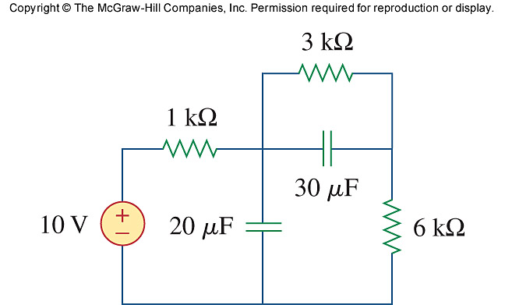
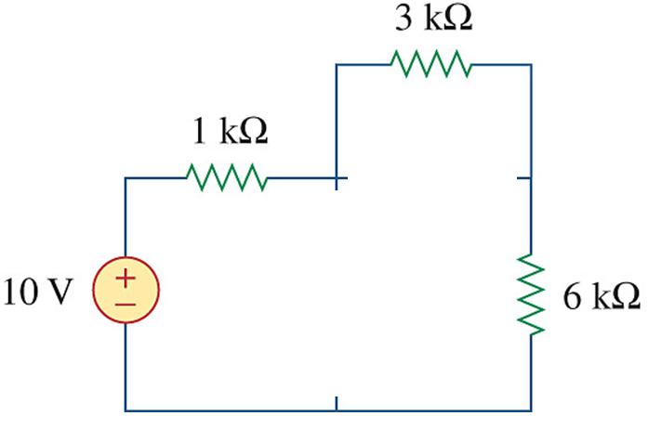
PP 6.5 For DC conditions, calculate the energy stored in the two capacitors.
+ V₃₀ –
V_{30μF} = 3 V
w = 0.5Cv²
= 0.5 × 30×10⁻⁶ × 3²
= 135 μJ
+ V₂₀ –
V_{20μF} = (3+6) = 9 V
w = 0.5Cv²
= 0.5 × 20×10⁻⁶ × 9²
= 810 μJ
+ 3V –
+ V₃₀ –
+ 1V –
+ V₂₀ –
+ 6V –

Slide 10
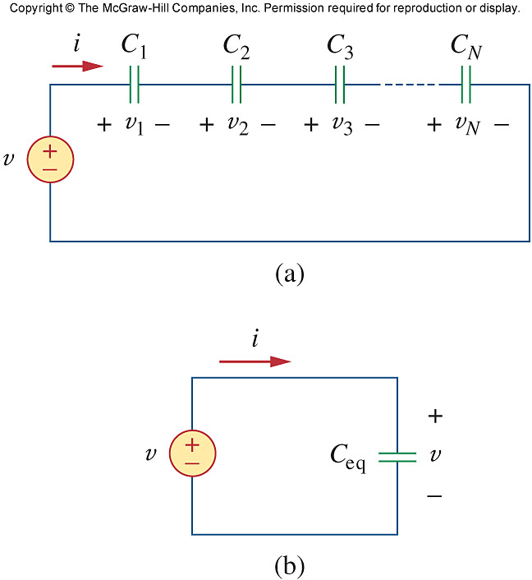
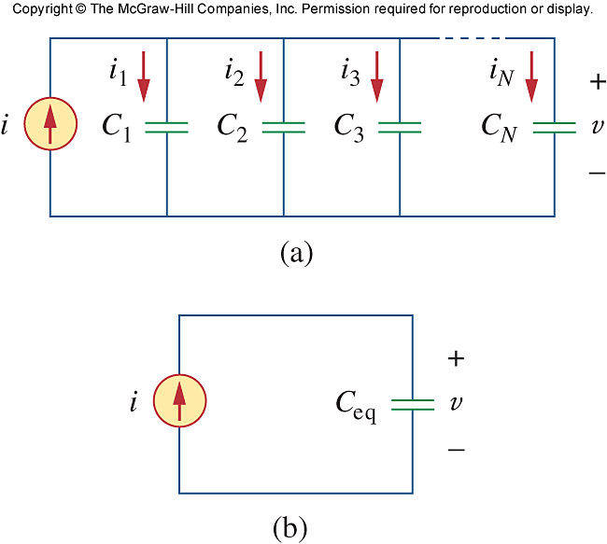
6.3 Series and Parallel Capacitors

Slide 11
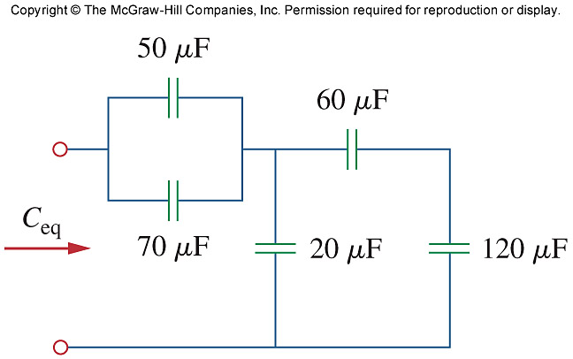
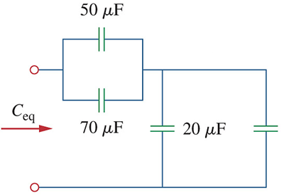
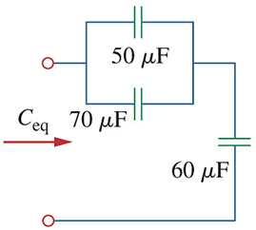
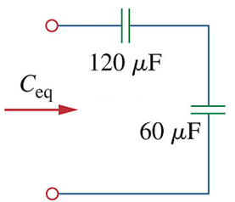
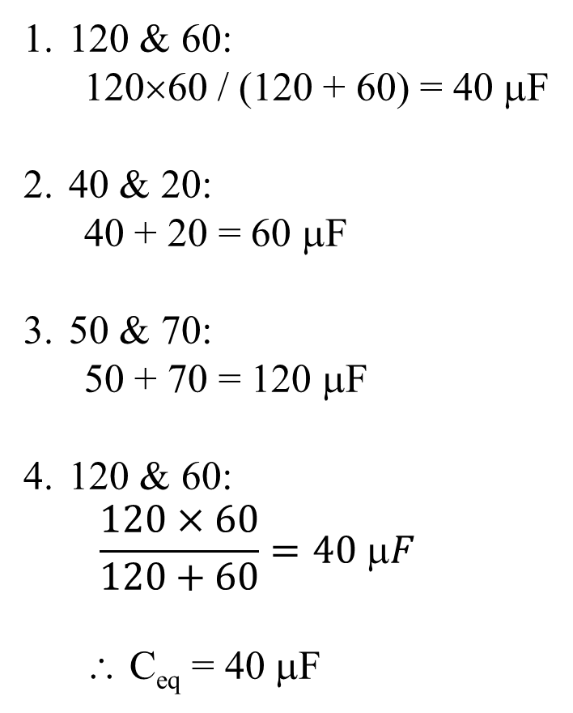
PP 6.6 Determine the equivalent capacitance
120 & 60:
120×60 / (120 + 60) = 40 μF
40 & 20:
40 + 20 = 60 μF
50 & 70:
50 + 70 = 120 μF
120 & 60:
$$\frac{120×60}{120+60}=40 μF$$
∴ C_{eq} = 40 μF
40 μF

Slide 12
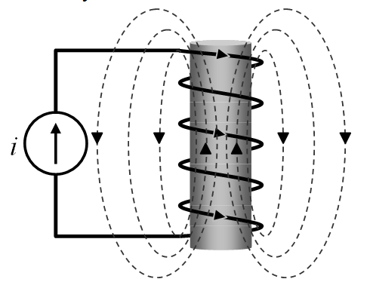
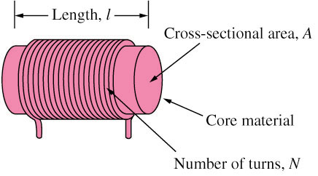
Ch. 6 L#2 6.4 Inductors Physical characteristics
An inductor is a passive element designed to store energy in its magnetic field.
An inductor consists of a coil of conducting wire.
Core from iron, steel, plastic or air.
μ = permeability = μ_{r}μ₀

Slide 13
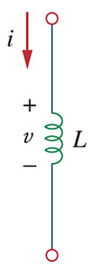
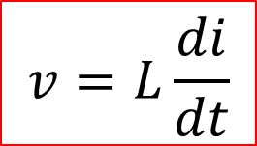
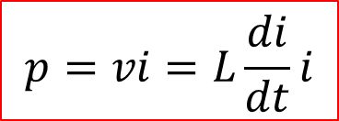
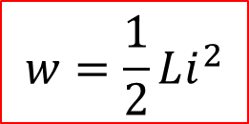
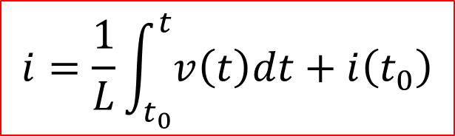
6.4 Inductors Electrical characteristics
$$v=L\frac{di}{dt}$$
$$i=\frac{1}{L}\int_{t_{0}}^{t}{v\left(t\right)dt}+i\left(t_{0}\right)$$
$$w=\frac{1}{2}Li^{2}$$
$$p=vi=L\frac{di}{dt}i$$
Important characteristics of inductors:
It is a short circuit to DC (di/dt = 0).
Its current cannot change abruptly (di/dt = ∞).
Does not dissipate energy, but stores it when charging or provides it when discharging.

Slide 14

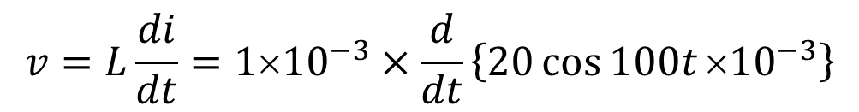
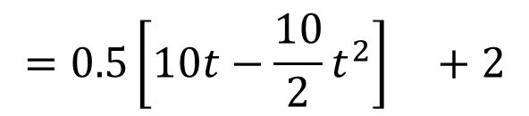
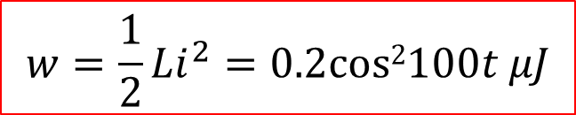
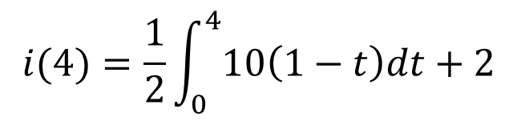

PP 6.8 The current through a 1 mH inductor is i(t) = 20 cos 100t mA. Calculate the voltage and the stored energy.
$$v=L\frac{di}{dt}=1×{10}^{−3}×\frac{d}{dt}\left\{20\cos{100t}×{10}^{−3}\right\}$$
$$=1×{10}^{−3}×20×{10}^{−3}×100×−\sin{100t}$$
$$=−2\sin{100t} mV$$
$$w=\frac{1}{2}Li^{2}=0.2cos2100t μJ$$
PP 6.9 The voltage across a 2 H inductor is v(t) = 10(1 – t) V.
Determine the current through the inductor at t = 4 s if i(0) = 2 A.
$$i(4)=\frac{1}{2}\int_{0}^{4}{10\left(1−t\right)dt}+2$$
4
$$=0.5\left[10t−\frac{10}{2}t^{2}\right] +2$$
0
$$=−18 A$$

Slide 15
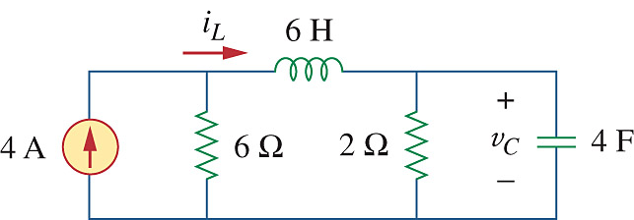
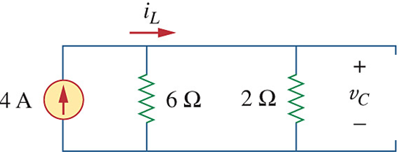
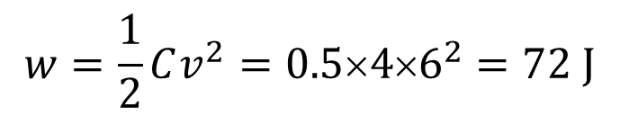
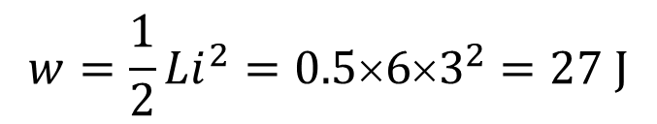


PP 6.10 Determine v_{C}, i_{L} and the energy stored in both the capacitor and the inductor for the DC circuit below.
$$i_{L}=4\frac{6}{6+2}=3 A$$
$$w=\frac{1}{2}Li^{2}=0.5×6×3^{2}=27 J$$
$$v_{C}=2i_{L}=6 V$$
$$w=\frac{1}{2}Cv^{2}=0.5×4×6^{2}=72 J$$

Slide 16


6.4 Series and Parallel Inductors

Slide 17

Current and voltage relationship for R, L, C
+
+
+

Slide 18

PP 6.11 Calculate L_{eq}
40+20 = 60
60//30 = 20
20+100 = 120
120//40 = 30
30+20 = 50
50//50 = 25 mH = L_{eq}

Slide 19

PP 6.12 If i₁(t) = 0.6e^{-2t} A and i(0) = 1.4 A ,find
a) i₂(0) (b) i₂(t) and i(t) (c) v₁(t), v₂(t) and v(t)
i₁(0) = 0.6 A
KCL: i₂(0) = i(0) – i₁(0)
= 1.4 – 0.6 = 0.8 A

Slide 20

PP 6.12 continued If i₁(t) = 0.6e^{-2t} A and i(0) = 1.4 A ,find
(b) i₂(t) and i(t) (c) v₁(t), v₂(t) and v(t)
i₂(0) = 0.8 A
$$i_{2}\left(t\right)=\frac{1}{L}\int{v_{1}dt}+i_{2}\left(0\right) ∴need v_{1}$$
$$v_{1}(t)= L1\frac{di_{1}}{dt}=6\frac{d}{dt}\left\{0.6e^{−2t}\right\}$$
$$=6×−2×0.6e^{−2t}$$
$$=−7.2e^{−2t} V$$
$$i_{2}\left(t\right)=\frac{1}{3}\int_{0}^{t}{−7.2e^{−2t}dt}+0.8=\frac{−7.2}{3}\left[\frac{1}{−2}e^{−2t}\right] +0.8$$
$$=1.2\left[e^{−2t}−1\right]+0.8$$
$$=1.2e^{−2t}−0.4 A$$
t
0

Slide 21




PP 6.12 continued … If i₁(t) = 0.6e^{-2t} A and i(0) = 1.4 A ,find
(b) i₂(t) and i(t) (c) v₁(t), v₂(t) and v(t)
$$v_{1}(t\text{)}=−7.2e^{−2t} V$$
$$i_{2}\left(t\right)=1.2e^{−2t}−0.4 A$$
KCL:
$$i(t\text{)}=i_{1}\left(t\right)+i_{2}\left(t\right)$$
$$=0.6e^{−2t}+1.2e^{−2t}−0.4 A$$
$$=1.8e^{−2t}−0.4 A$$
$$v_{2}(t)= L\frac{di}{dt}=8\frac{d}{dt}\left\{1.8e^{−2t}−0.4\right\}$$
$$=8×−2×1.8e^{−2t}$$
$$=−28.8e^{−2t} V$$
KVL:
$$v(t\text{)}=v_{1}\left(t\right)+v_{2}\left(t\right)$$
$$=−7.2e^{−2t}−28.8e^{−2t}$$
$$=−36e^{−2t} V$$

Slide 22







Problem 6.40 The current through a 10 mH inductor is shown below. Determine the voltage across the inductor at t = 1, 3 and 5 ms.
$$v\left(t\right)=0.01\frac{di}{dt}=0.01\frac{Δi}{Δt}$$
$$v\left(1ms\right)=0.01\frac{20−0}{0.002 −0}=100 V$$
$$v\left(3ms\right)=0 V because \frac{di}{dt}=0$$
OR
$$v\left(5ms\right)=−100 V$$
$$i\left(t\right)=\frac{Δi}{Δt}t+c=\frac{20−0}{0.002 −0}t+0=10t kA$$
$$v\left(t\right)=0.01\frac{di}{dt}=0.01×10000=100 V$$

Slide 23




Problem 6.48 Under steady state dc conditions, find i and v.
$$i=10mA×\frac{30}{30+20}=6mA$$
$$v=6 mA×20 k=120 V$$

